Slide 1


DAT490 - Data Science Capstone Progress Report
Analysis of Airline Cost Efficiencies
Jood Alaswad, Arnol Garcia, Marissa Miller, Brandon Thacker

Slide 2


02
DAT490 - Data Science Capstone 2026
01
Introduction
Contents of the Report
02
Literature Review
03
Methodology
04
Current Progress and Next Steps
April 5th,
2026

Slide 3

Section
01
Introduction
April 5th,
2026
DAT490 - Data Science Capstone 2026

Slide 4
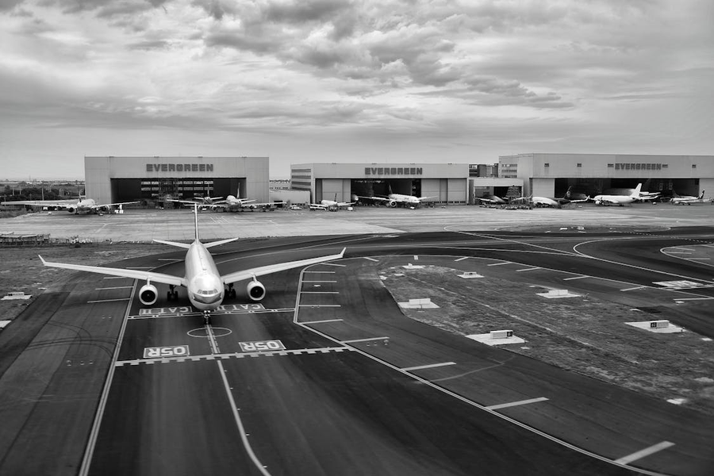
04
DAT490 - Data Science Capstone 2026
Introduction
20-25%
The U.S. airline industry is highly competitive and focused on controlling costs while maintaining efficiency and performance. Low-cost carriers are often seen as more efficient, while legacy airlines may provide better service, reliability, and more flight options.
The United States consistently dominates global air traffic, handling roughly 20-25% of worldwide air travel.
We will discuss whether reducing costs actually improves operations or results in trade-offs that harm service quality. Does a lower operating cost lead to profit maximization in their domestic market?
April 5th,
2026

Slide 5
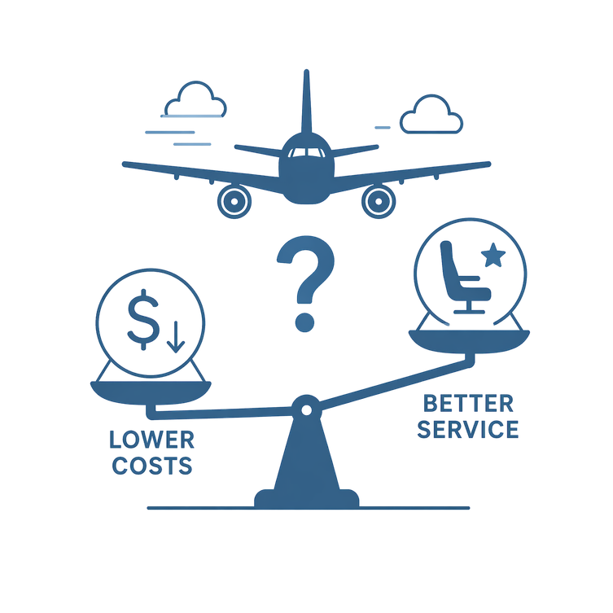
05
DAT490 - Data Science Capstone 2026
Motivating Problems
Airlines try to reduce costs while maintaining reliable service
Low-cost carriers are often seen as more efficient
It is unclear whether lower costs improve or hurt performance
What is the relationship between airline cost efficiency and operational performance, and are there trade-offs between cost minimization and service quality?
April 5th,
2026

Slide 6
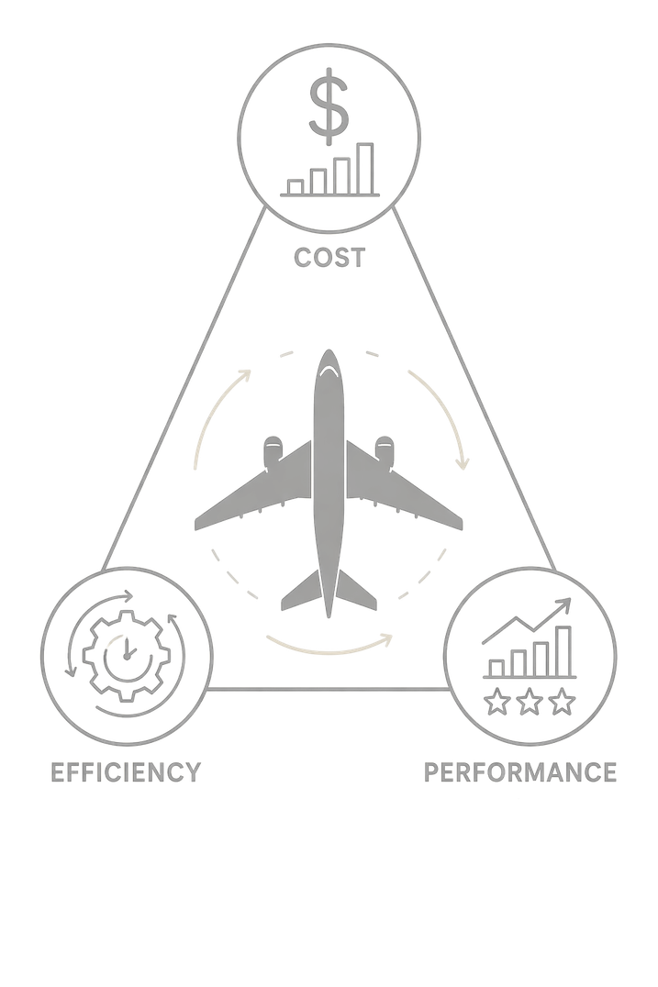
DAT490 - Data Science Capstone 2026
Research questions
How do different cost structures relate to operational efficiency measures such as load factor, capacity utilization, and passengers per flight?
Is there a relationship between operating costs and service performance metrics such as delays, reliability, and cancellations?
How do low-cost and legacy carriers differ in their balance between cost, efficiency, and performance?
How have these relationships changed across pre-COVID, COVID, and post-COVID periods?
April 5th,
2026
06

Slide 7
Section
02
Literature Review
April 5th,
2026
DAT490 - Data Science Capstone 2026

Slide 8
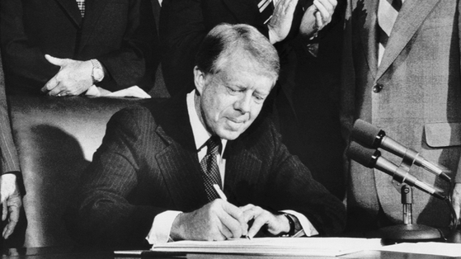
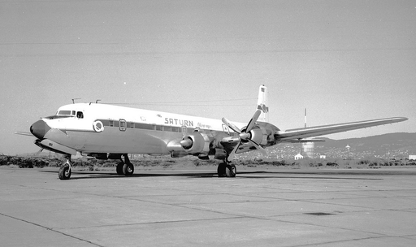
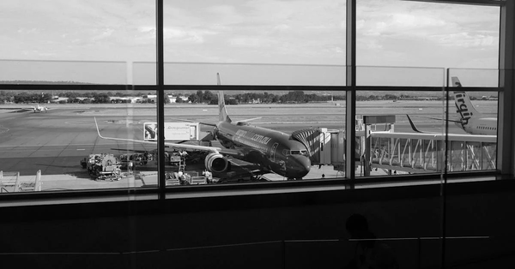
08
DAT490 - Data Science Capstone 2026
1978 deregulation
U.S. airline deregulation increased competition and cost pressure
Literature Review
Rise of low-cost carriers
The literature shows that airline efficiency is shaped by business model, network design, and cost structure. Low-cost carriers often appear more cost-efficient, but lower costs do not always translate to better service outcomes. Across the literature, a key open question is whether cost minimization improves operational performance or creates trade-offs in delays, cancellations, and reliability.
Low-cost and legacy carriers developed distinct business models
Modern competition and efficiency focus
April 5th,
2026
Efficiency depends on utilization, network design, and scale

Slide 9

Controversies and Open Questions
Controversies
Are delays a sign of inefficiency, or a byproduct of hub optimization?
Are low-cost carriers always more efficient, or does this depend on how efficiency is measured?
Open questions
Do lower operating costs improve performance or create service trade-offs?
Did these relationships change after COVID?
April 5th,
2026
02

Slide 10
Section
03
Methodology
April 5th,
2026
DAT490 - Data Science Capstone 2026

Slide 11
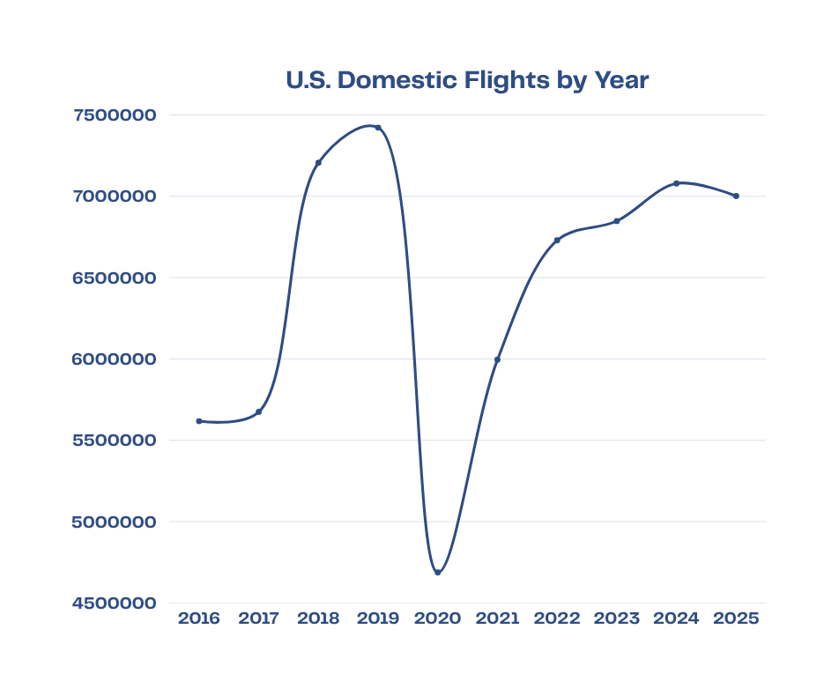
11
DAT490 - Data Science Capstone 2026
COVID-19 as a Structural Break
Major demand shock
Severe financial losses and disruptions
Recovery patterns differed by airline type
Justifies dividing analysis into:
Pre-Covid
Covid
Post-Covid
2016-2019
2020-2021
2022-2025
Pre-Covid
Covid
Post-Covid
April 5th,
2026

Slide 12
April 5th,
2026
Major Datasets
BTS Form 41
BTS T-100
BTS On-Time Performance
Financial and operating expense data
Passengers, departures, capacity, traffic
Delays, cancellations, reliability
Cost + Efficiency + Performance
12
DAT490 - Data Science Capstone 2026

Slide 13
April 5th,
2026
Proposed Methodolog
01
02
03
Construct Indicators
Compare Airline Types
Analyze Relationships
Cost per passenger
Cost per departure
Load factor
Passengers per flight
Delay rate
Cancellation rate
Reliability measures
Low-cost vs legacy carriers
Pre-COVID vs COVID vs post-COVID
Regression models
Comparative analysis
Possible clustering of airlines by cost/performance profile
13
DAT490 - Data Science Capstone 2026

Slide 14
Examining Questions
April 5th,
2026
Finding a relationship between cost structures and operational efficiency metrics.
Observe the impact of operating costs on service performance indicators.
Predict the differences between the airline business models in balancing cost, efficiency, and performance.
Key Question
CARRIER,
OpExpenses,
UNIQUE_CARRIER,
OpRevenues,
TRAFFIC_EXPENSE,
FOOD_EXPENSE
AIR_OP_EXPENSE
NetIncome,
OpProfitLoss,
Metric
Definition
Match the carrier ID with the route, aircraft, and segment. Obtain and coordinate data from datasets to develop into numeric variables.
Observe the indicator of Airline Profitability. Comparing cost per mile, cost per passenger, revenue per mile, and revenue per passenger.
Understand and measure route profitability. If the Airline is operating efficiently. Is the airline's pricing strategy profitable?
09
DAT490 - Data Science Capstone 2026

Slide 15
Section
04
Current Progress and Next Steps
April 5th,
2026
DAT490 - Data Science Capstone 2026

Slide 16
April 5th,
2026
Current Progress + Next Steps
Completed
Defined motivating question and sub-questions
Reviewed literature on airline efficiency and performance
Identified major datasets
Developed preliminary methodology
Next Steps
Clean and merge BTS datasets
Construct KPIs
Run initial descriptive analysis and regression models
Refine comparisons by airline type and time period
15
DAT490 - Data Science Capstone 2026

Slide 17
16
DAT490 - Data Science Capstone 2026
Conclusion
Highlight
Highlight
01
This project examines whether lower-cost airline strategies are associated with stronger operational outcomes or with trade-offs in service quality.
02
The literature suggests that efficiency is shaped by business model, network design, and resource utilization, not by cost alone.
Highlight
Highlight
03
Using BTS financial, traffic, and on-time performance data, the analysis compares airlines across pre-COVID, COVID, and post-COVID periods.
04
The goal is to better understand how airlines balance cost, efficiency, and performance in a competitive and changing market.
April 5th,
2026

Slide 18
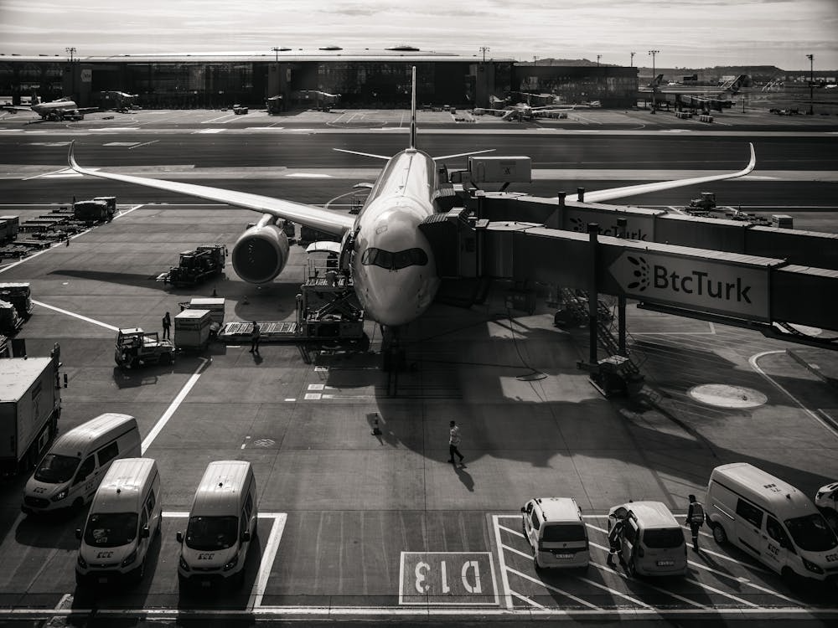
Thank You!
Presented by: Jood Alaswad, Arnol Garcia, Marissa Miller, Brandon Thacker

